Slide 1
Strategic and Change Management A very brief introduction
Presented
by
Dennis Smith - CM(SA)
13/02/16

Slide 2
Additional Reading
Strategic Advantage through the Management of Innovation and Technology - Burgelman, Christensen Wheelwright
Strategy Pure and Simple 1 and 2 Robert Michel
Jack – Jack Welch
Rise and Fall of Strategic Planning - Minzberg
The New Market Leaders Fred Wiersema
Making Sense of Strategy – Tony Manning

Slide 3
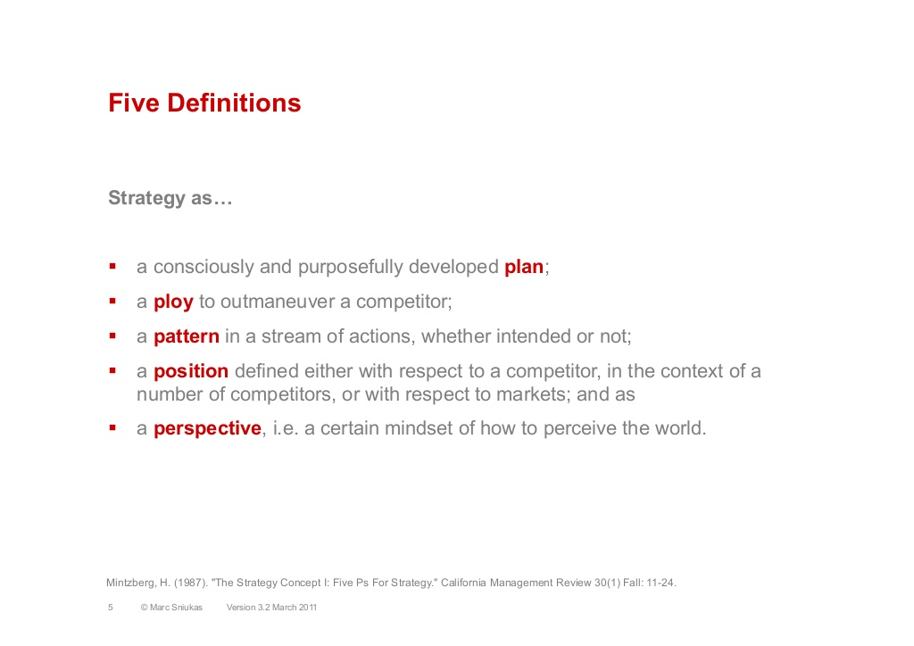
Strategy ?
Strategic planning and execution in the twenty first century is essential in retaining a market leadership position and in ensuring sustainable, meaningful results for most of the stakeholders.

Slide 4
STRATEGY AND COMPETITORS
Strategy is about competing differently from rivals—
Doing what they don’t do or doing it better!
Doing what they can’t do!
Doing things in ways that attract customers and set a firm apart from its rivals.
Doing things in a manner calculated to produce a competitive edge over rivals.

Slide 5
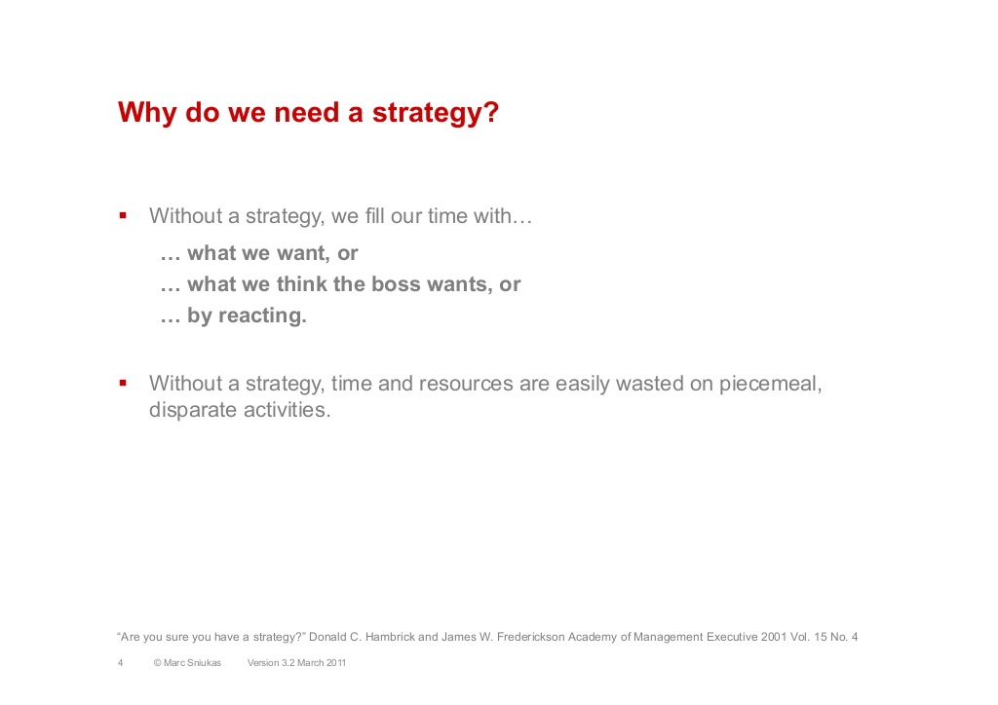

Slide 6
STRATEGY AND THE QUEST FOR COMPETITIVE ADVANTAGE
A firm achieves a competitive advantage when it provides buyers with superior value compared to rival sellers or offers the same value at a lower cost to the firm.
Requires meeting customer needs either more effectively (with products or services that customers value more highly) or more efficiently (by providing products or services at lower cost).
The firm achieves a sustainable competitive advantage if its advantage persists despite the best efforts of competitors to match or surpass its advantage.
Requires giving buyers lasting reasons to prefer a firm’s products or services over those of its competitors.

Slide 7
WHY A COMPANY’S STRATEGY EVOLVES OVER TIME
Changing circumstances and ongoing management efforts to improve the strategy cause a company’s strategy to evolve over time—a condition that makes the task of crafting strategy a work in progress, not a one-time event.
Managers modify strategy in response to:
Changing market conditions
Advancing technology
Fresh moves of competitors
Shifting buyer needs
Emerging market opportunities
New ideas for improving the strategy
A company’s strategy is shaped partly by management analysis and choice and partly by the necessity of adapting and learning by doing.

Slide 8

WHAT IS STRATEGIC PLANNING?
Strategic planning or Management is a continuous,
interactive process
aimed at keeping an organisation as a whole
appropriately matched to its environment.
S.C CERTO and J.P PETER
Strategic Planning or Management is the
art and science
of formulating, implementing and evaluating cross-functional decisions that enable an organisation to achieve its objectives.
FRED R. DAVID

Slide 9
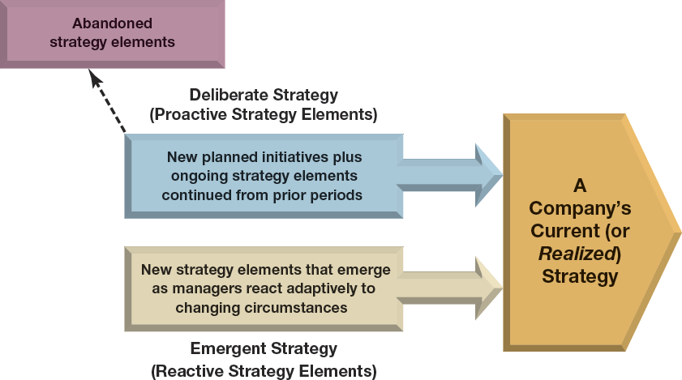
FIGURE 1.2
A Company’s Strategy Is a Blend of Proactive Initiatives and Reactive Adjustments

Slide 10
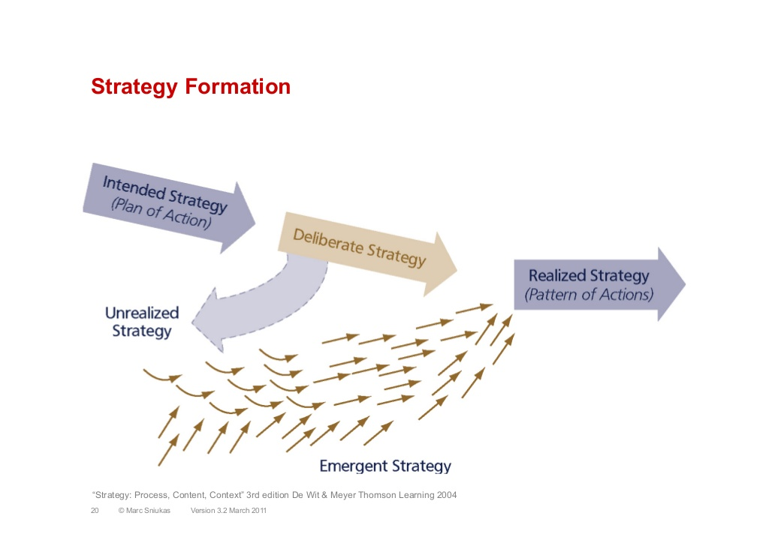

Slide 11
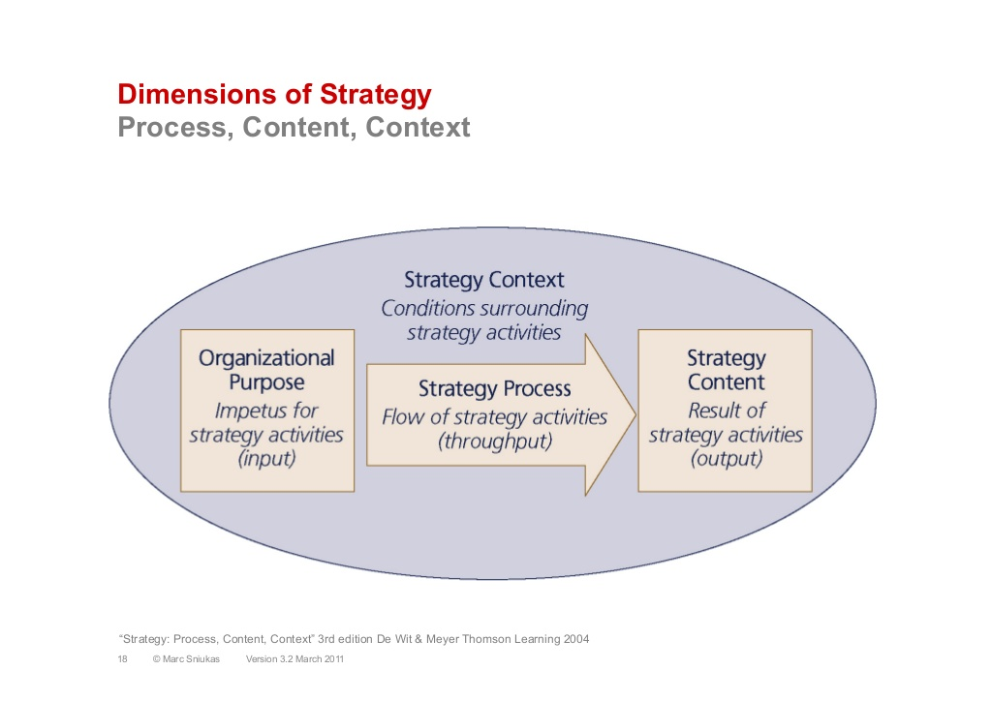

Slide 12
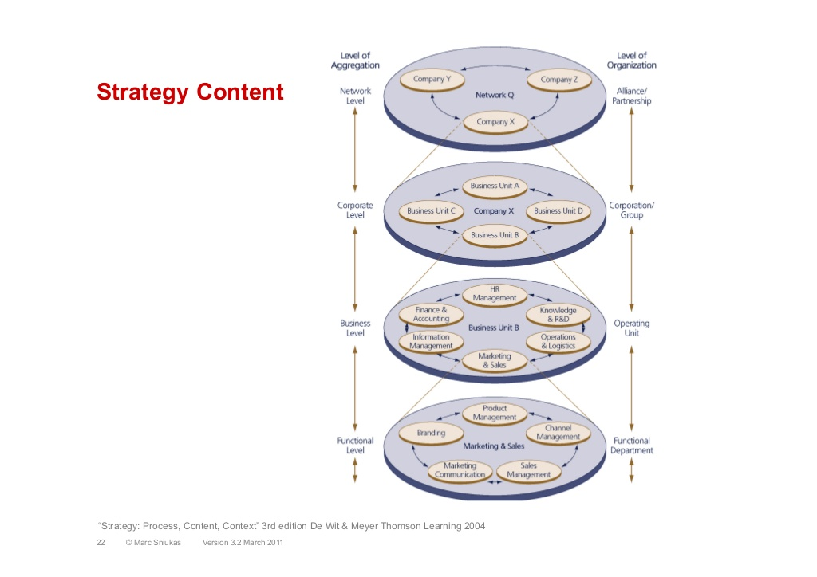

Slide 13
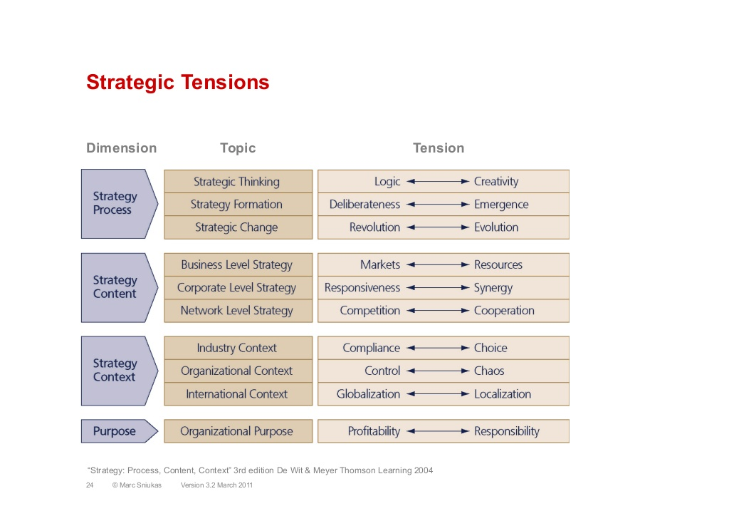

Slide 14
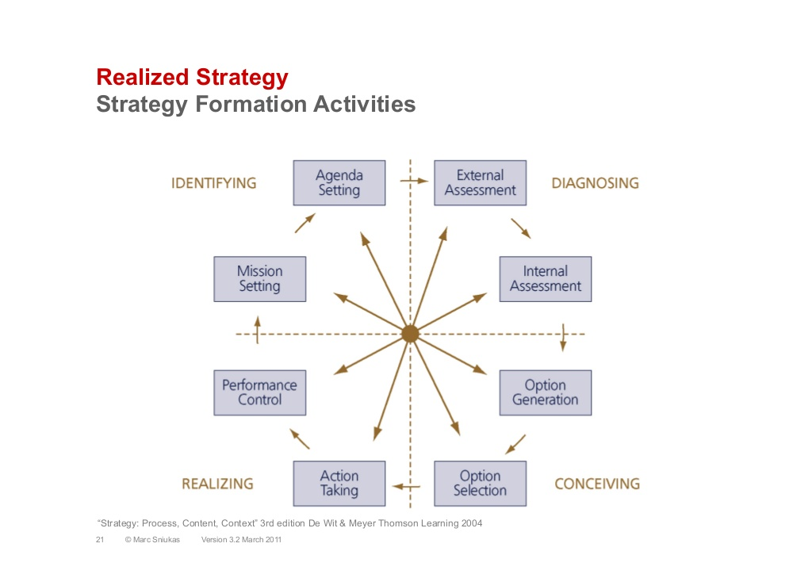

Slide 15
STRATEGIC APPROACH CHOICES
Building Competitive Advantage
Low-cost provider
Differentiation on features
Focus on market niche
Best-cost provider
Building a competitive advantage by:
Striving to become the industry’s low-cost provider (efficiency).
Outcompeting rivals on differentiating features (effectiveness).
Offering the lowest (best) prices for differentiated goods (best-cost provider).
Focusing on better serving a niche market’s needs (efficiency and\or effectiveness).

Slide 16
GAINING SUSTAINABLE COMPETITIVE ADVANTAGE
How to create a sustainable competitive advantage:
Develop valuable expertise and competitive capabilities over the long-term that rivals cannot readily copy, match or best.
Put the constant quest for sustainable competitive advantage at center stage in crafting your strategy.

Slide 17


THE RELATIONSHIP BETWEEN A FIRM’S STRATEGY AND ITS BUSINESS MODEL
Realized Strategy
Business Model
$$$?
Competitive Initiatives
Value Proposition
Business Approaches
Profit Formula

Slide 18
A COMPANY’S STRATEGY AND ITS BUSINESS MODEL
How the business will make money :
By providing customers with value.
The firm’s customer value proposition
By generating revenues sufficient to cover costs and produce attractive profits.
The firm’s profit formula
It takes a proven business model—one that yields appealing profitability—to demonstrate viability of a firm’s strategy.

Slide 19
BUSINESS MODEL ELEMENTS
The Customer Value Proposition
Satisfying buyer wants and needs at a price customers will consider a good value.
The greater the value provided (V) and the lower the price (P), the more attractive the value proposition is to customers.

Slide 20
BUSINESS MODEL ELEMENTS (CONT’D)
The Profit Formula
Creating a cost structure that allows for acceptable profits, given that pricing is tied to the customer value proposition.
V—the value provided to customers
P—the price charged to customers
C—the firm’s costs
The lower the costs (C) for a given customer value proposition (V–P), the greater the ability of the business model to be a moneymaker.

Slide 21
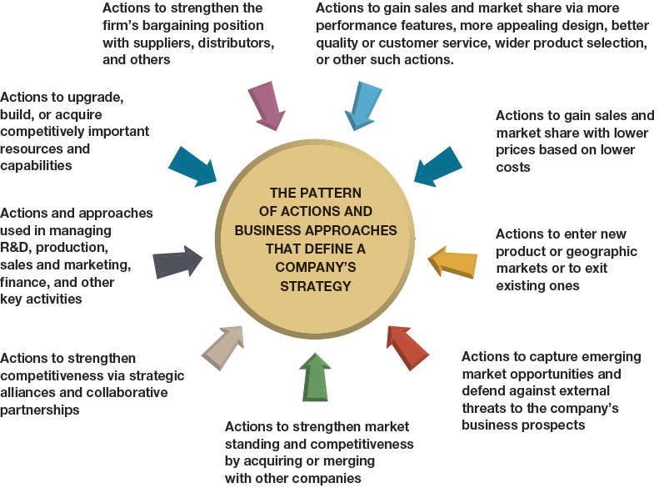
FIGURE 1.1
Identifying a Company’s Strategy–What to Look For

Slide 22
WHAT MAKES A STRATEGY A WINNER?
A winning strategy must pass three tests:
The Fit Test
Does it exhibit dynamic fit with the external and internal aspects of the firm’s overall situation?
The Competitive Advantage Test
Can it help the firm achieve a significant and sustainable competitive advantage?
The Performance Test
Can it produce good performance as measured by the firm’s profitability, financial and competitive strengths, and market standing?

Slide 23
WHY CRAFTING AND EXECUTING STRATEGY ARE IMPORTANT TASKS
Strategy provides:
A prescription for doing business.
A road map to competitive advantage.
A game plan for pleasing customers.
A formula for attaining long-term standout marketplace performance.
Good Strategy + Good Strategy Execution = Good Management

Slide 24
THE ROAD AHEAD
Strategy is about asking the right questions:
What must managers do, and do well, to make a firm a winner in the marketplace?
Strategy requires getting the right answers:
Good strategic thinking and good management of the strategy-making, strategy-executing process.
First-rate capabilities and skills in crafting and executing strategy are essential to managing successfully.
Welcome and best wishes for your success!

Slide 25
Seven challenges facing responsible African business
capitalism 3.0,
1.0 version is characterised by the pursuit of wild profit, with no care for law nor morality.
2.0 pursues legal profit and the
3.0 version emphasises legitimate profit.
legitimacy of profit depends, upstream, on how it is made and, downstream, on how it is used. Profit is legitimate if it is achieved without harming people and nature. Downstream, profit is legitimate if a significant share of it is reinvested in the development of the ecosystem that made it possible
clean development,
human capital,

Slide 26
Dennis Smith
Many years' experience in senior management roles
Initiative Consulting, specialising in organizational audits, strategic alignment, performance consulting and change management as well as various assessments.
MSc (MOTI)
CM (SA)
Registered constituent assessor, moderator and verifier
Developed employee perception index (EPI)
My career has spanned the following industries
Consulting industry with a strong focus on strategy development, strategic alignment, organisational effectiveness and efficiency,marketing
Lecturing and Facilitation - areas of specialisation are Strategic and change management, marketing, operations management, entrepreneurship and leadership
Fast moving consumer goods (FMCG) from brand manager to general management – multinationals and national companies
Automotive industry spanning both the retail and manufacturing environments - senior marketing and dealer development roles

